Slide 1

STABILITY AND STABILIZATION OF NETWORKED LOAD FREQUENCY CONTROL SYSTEMS INTEGRATED WITH ELECTRIC VEHICLE AGGREGATORS.
Presented By:
Sharini Rithigaa B S (17CE153).
Gokulnath M (17EE111).
Kalavagunta Vamshi (17EE118).
Kalla Anil Sai Kumar (17EE119).
Under the guidance of, Dr. K.Ramakrishnan, M.E., Ph.D.,
Associate Professor,
Department of EEE.

Slide 2
INTRODUCTION:
Whenever there is heavy power demand or power shortage the frequency of the voltage between the tie lines connecting Electric vehicle aggregator and smart grid reduces.
This reduction in frequency is sensed through sensor and the information is sent to information center by PI controller.
According to the level of reduction in frequency, the PI controller decides how much input of power to be extracted from the Electric Vehicle Aggregator.
Here, the Electric Vehicle Aggregator acts as source of power to compensate the demand of power along with the Smart Grid.

Slide 3
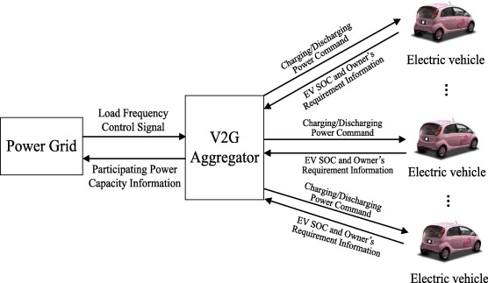
Fig 1. Integration of Electric Vehicle Aggregator to grid.

Slide 4
LITERATURE SURVEY:
This project deals with computation of communication time delays on stability regions and stability delay margins of the PI controller between the Electric Vehicle Aggregator and the smart grid of a single area load frequency control(LFC) system.
A graphical method of characterizing stability boundary locus is implemented.
For a given time delay, the method computes all the stability gains of PI controller, which constitutes a stability regions in parameters of space of PI controller.
Later a frequency domain exact method is used to calculate stability delay margins for various values of PI controller gains.
The complete analysis is made in order to pass the information of error in the system within the stability margin delay to bring the system to equilibrium point.

Slide 5
OBJECTIVES OF PROJECT:
To access the impact of integrating electrical vehicle aggregator on stability of single area load frequency control system.
The integration of geographically dispersed electric vehicle aggregator through communication network introduces time delay in closed loop control system.
The presence of time delay in feedback loop of the closed loop load frequency control system affects performance and stability of the system.
In this presentation, a methodology is presented to assess the maximum allowable bound of time delay within which the networked load frequency control system stays stable.

Slide 6
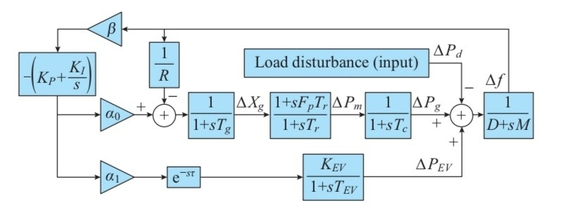
LFC SYSTEM MODEL WITH EV AGGREGATOR:
Fig. 1. System model of single-area LFC with EV aggregator.

Slide 7
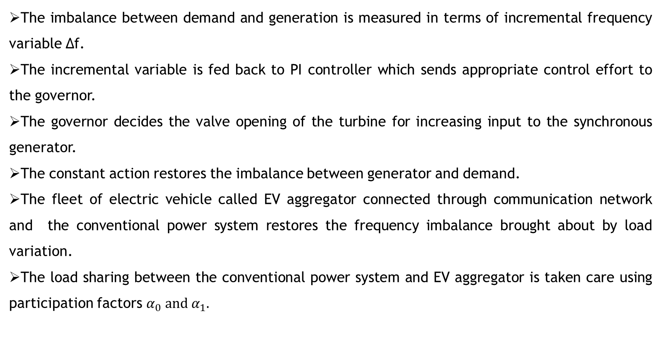
SYSTEM DESCRIPTION:
The imbalance between demand and generation is measured in terms of incremental frequency variable ∆f.
The incremental variable is fed back to PI controller which sends appropriate control effort to the governor.
The governor decides the valve opening of the turbine for increasing input to the synchronous generator.
The constant action restores the imbalance between generator and demand.
The fleet of electric vehicle called EV aggregator connected through communication network and the conventional power system restores the frequency imbalance brought about by load variation.
The load sharing between the conventional power system and EV aggregator is taken care using participation factors $α_{0} and α_{1}.$

Slide 8
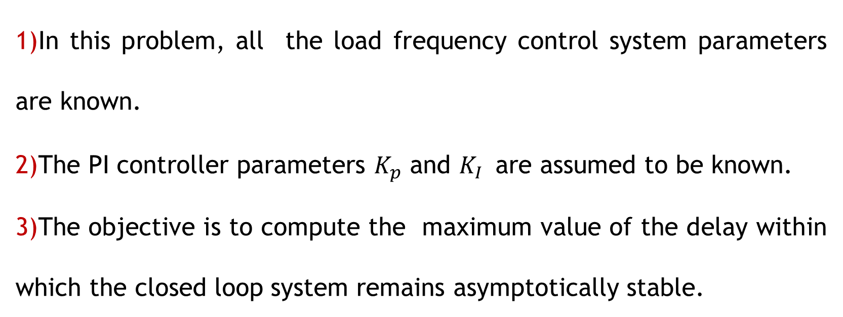
DELAY-DEPENDENT STABILITY PROBLEM:
In this problem, all the load frequency control system parameters are known.
The PI controller parameters $K_{p}$ and $K_{I }$ are assumed to be known.
The objective is to compute the maximum value of the delay within which the closed loop system remains asymptotically stable.

Slide 9
DELAY DEPENDANT STABILITY MARGIN:
$τ^{∗}$ - STABILITY DELAY MARGIN (s)
K_{p} | K_{I}=0.2 | K_{I}=0.4 | K_{I}=0.6 | K_{I}=0.8 | K_{I}=1.0
0 | 1.7866 | 0.4231 | 0.0859 | -0.0615 | -0.1417
0.1 | 2.7421 | 0.8271 | 0.3496 | 0.1340 | 0.0134
0.2 | 3.5861 | 1.2002 | 0.6018 | 0.3242 | 0.1656
0.3 | 4.2522 | 1.5214 | 0.8327 | 0.5034 | 0.3115
0.4 | 4.6970 | 1.7773 | 1.0346 | 0.6669 | 0.4477
0.5 | 4.8537 | 1.9635 | 1.2023 | 0.8108 | 0.5717
0.6 | 4.6817 | 2.0829 | 1.3339 | 0.9327 | 0.6812
0.7 | 4.3135 | 2.1433 | 1.4300 | 1.0317 | 0.7751
0.8 | 3.9050 | 2.1545 | 1.4932 | 1.1080 | 0.8527
0.9 | 3.5197 | 2.1273 | 1.5275 | 1.1628 | 0.9142
1.0 | 3.1740 | 2.0715 | 1.5372 | 1.1982 | 0.9606

Slide 10
STABILIZTION ON CONTROLLER SYNTHESIS PROBLEM:
In the problem, all the LFC system parameters except controller parameters are known.
The time-delay in the communication network is assumed to be known.
The objective is to compute a feasible origin in PI controller parametric space.

